Slide 1
By Dr. Kris Acheson-Clair
Seeing You Seeing Me

Slide 2
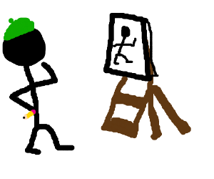
Time to Draw!
Take 2 minutes to sketch a self-portrait: How do you see yourself?
Now, around the edges of your self-portrait, write in some labels that describe social groups that you identify with – use nouns (e.g., college student, scientist, etc.).
On another sheet of paper, draw a new portrait. This time, draw yourself through the eyes of other people: How do you see others seeing you?
On this second portrait, write in some labels that capture how you think others would describe you – use adjectives (e.g., tall, funny, etc.). It is OK if these are positive, negative, or whatever comes to mind.

Slide 3
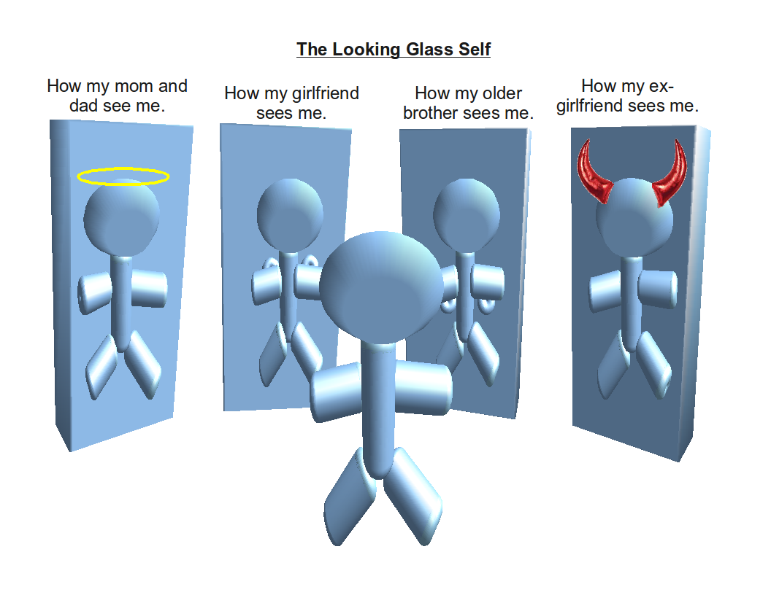
Time to Learn!
The Looking Glass Self (1902, Charles Cooley)
Interactive process:
We imagine how we appear to others
Others react to us and we interpret those reactions
We adjust our self-image accordingly and develop feelings about ourselves
Notes:
Mention toddler hide and seek (you can’t see me if I can’t see you) – unaware of self as an object at that age
But eventually we learn not only that the self is an object for others – we learn to see ourselves through others’ eyes
Tell a personal story of gaining this self-awareness of how others see you. For me, one of the first moments was in S. Korea (contrasts, kidnapping, etc.)

Slide 4
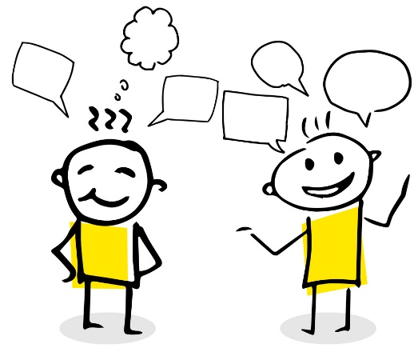
Time to Talk!
Food for thought in your small groups:
How are the nouns in the one picture related to the adjectives in the other? Which identities are most related to the characteristics others attribute to you? Which group memberships are they seeing?
Are your two self-portraits different in any way? If so, what do those differences say about the tension between how you see yourself and how you see others seeing you? Which portrait do you prefer?
What do the two pictures have in common? What do these similarities say about the insights of the Looking Glass Self? How do we unconsciously let others define us in our own minds? Who has been most influential in shaping your self image in this way? How happy are you about that influence? What can you do about it?
Notes:
Begin with group debriefing question before splitting into small groups: How are you feeling about this activity so far? What is your comfort level with talking about identity and self-perception?
In person, go back and forth between a question in small groups and a large group debriefing for maximum interactivity. Online, post all prompts in chat and then send to breakout rooms, debriefing upon return to whole group.
If time, additional whole group questions could include:
In debriefing of 1st set of prompts above:
Are there any noun labels that other people assume should be on your self-portrait but are not?
Are there any that are especially hidden from other people – no one knows unless you identity them to others?
Are there adjectives you wish were on the 2nd portrait? Anything you wish were NOT there?
In debriefing 2nd set of prompts:
Are there people in your life that, if I had asked you to think of them in particular, your 2nd picture would have been drastically different? In what ways?
In debriefing 3rd set of prompts:
Does anyone have a specific example they are willing to share – a story that illustrates the process of the looking glass self in action? I’ll start… (for me – share changing the way I introduce myself and my accent when I visit my parents)

Slide 5
Thanks!
krisac@purdue.edu
www.purdue.edu/ippu/cilmar/

